Slide 1




Slide 2

Microsoft Teams MS-700
Set Custom Streaming Policy in Microsoft Teams

Slide 3
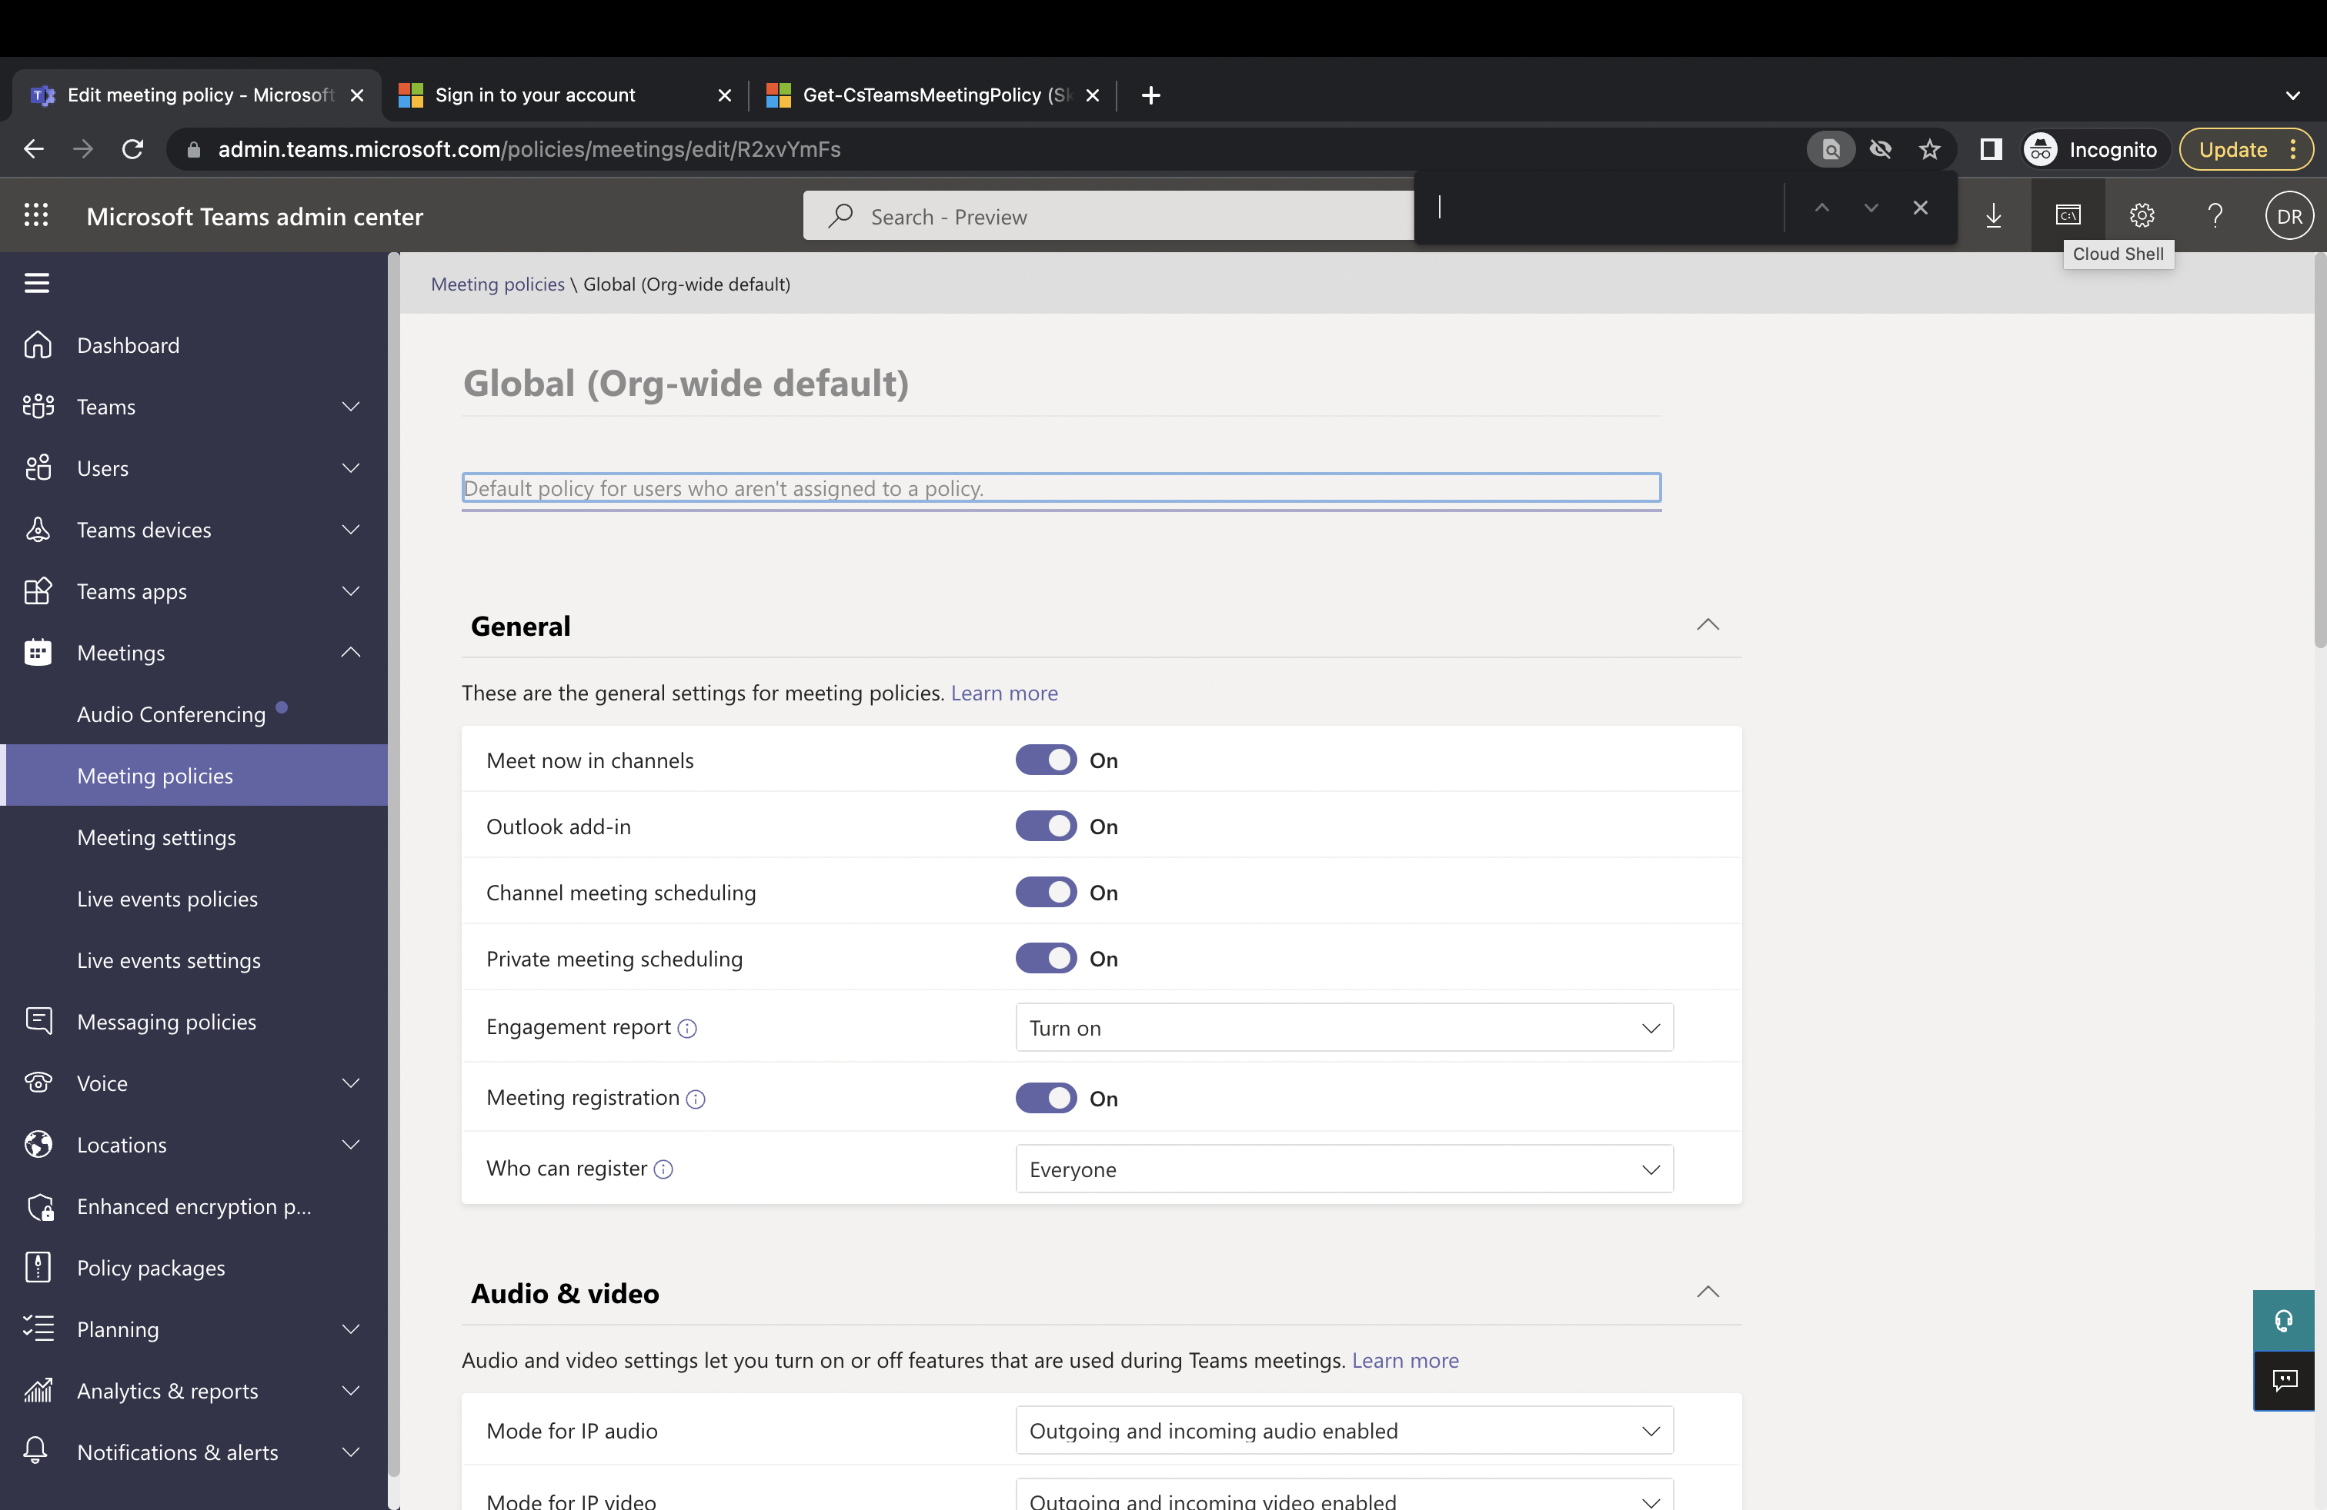
Upper Right – Click on Cloud Shell

Slide 4
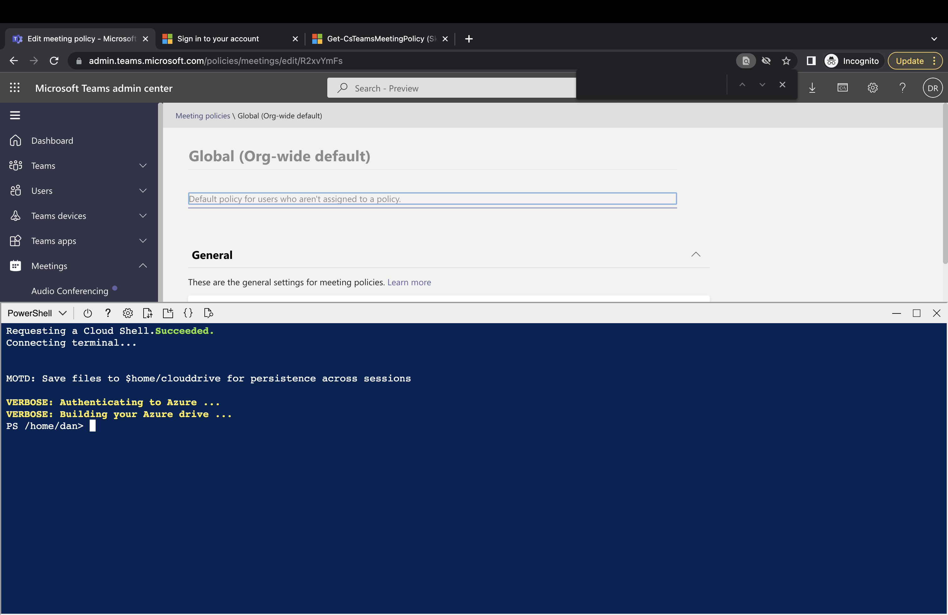
Then Three Commands

Slide 5
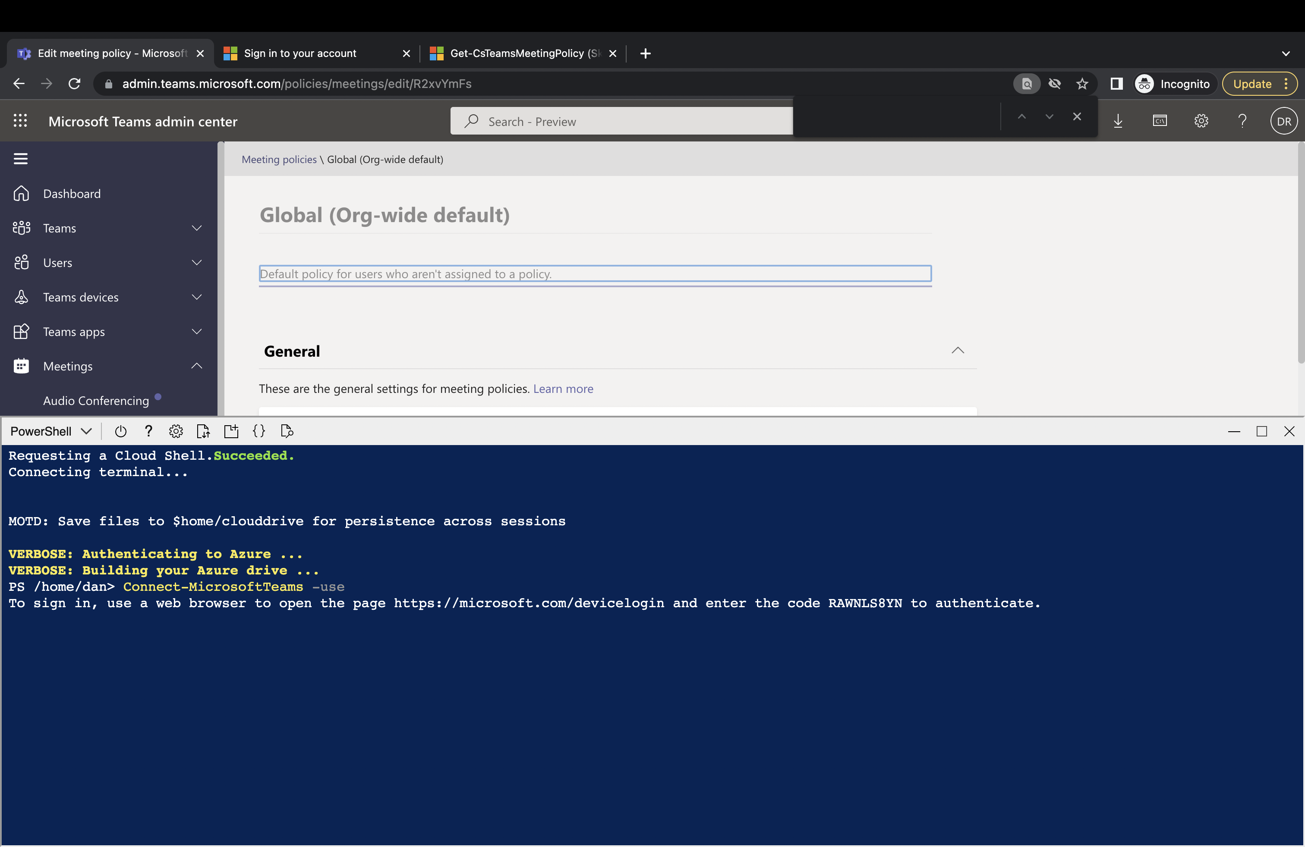
In the Cloud Shell (PowerShell) Window:
Connect-MicrosoftTeams -use

Slide 6
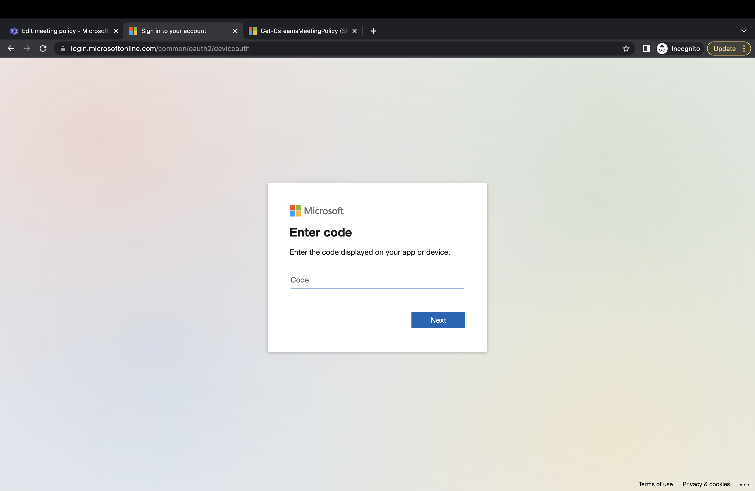
Enter the Code from previous command

Slide 7
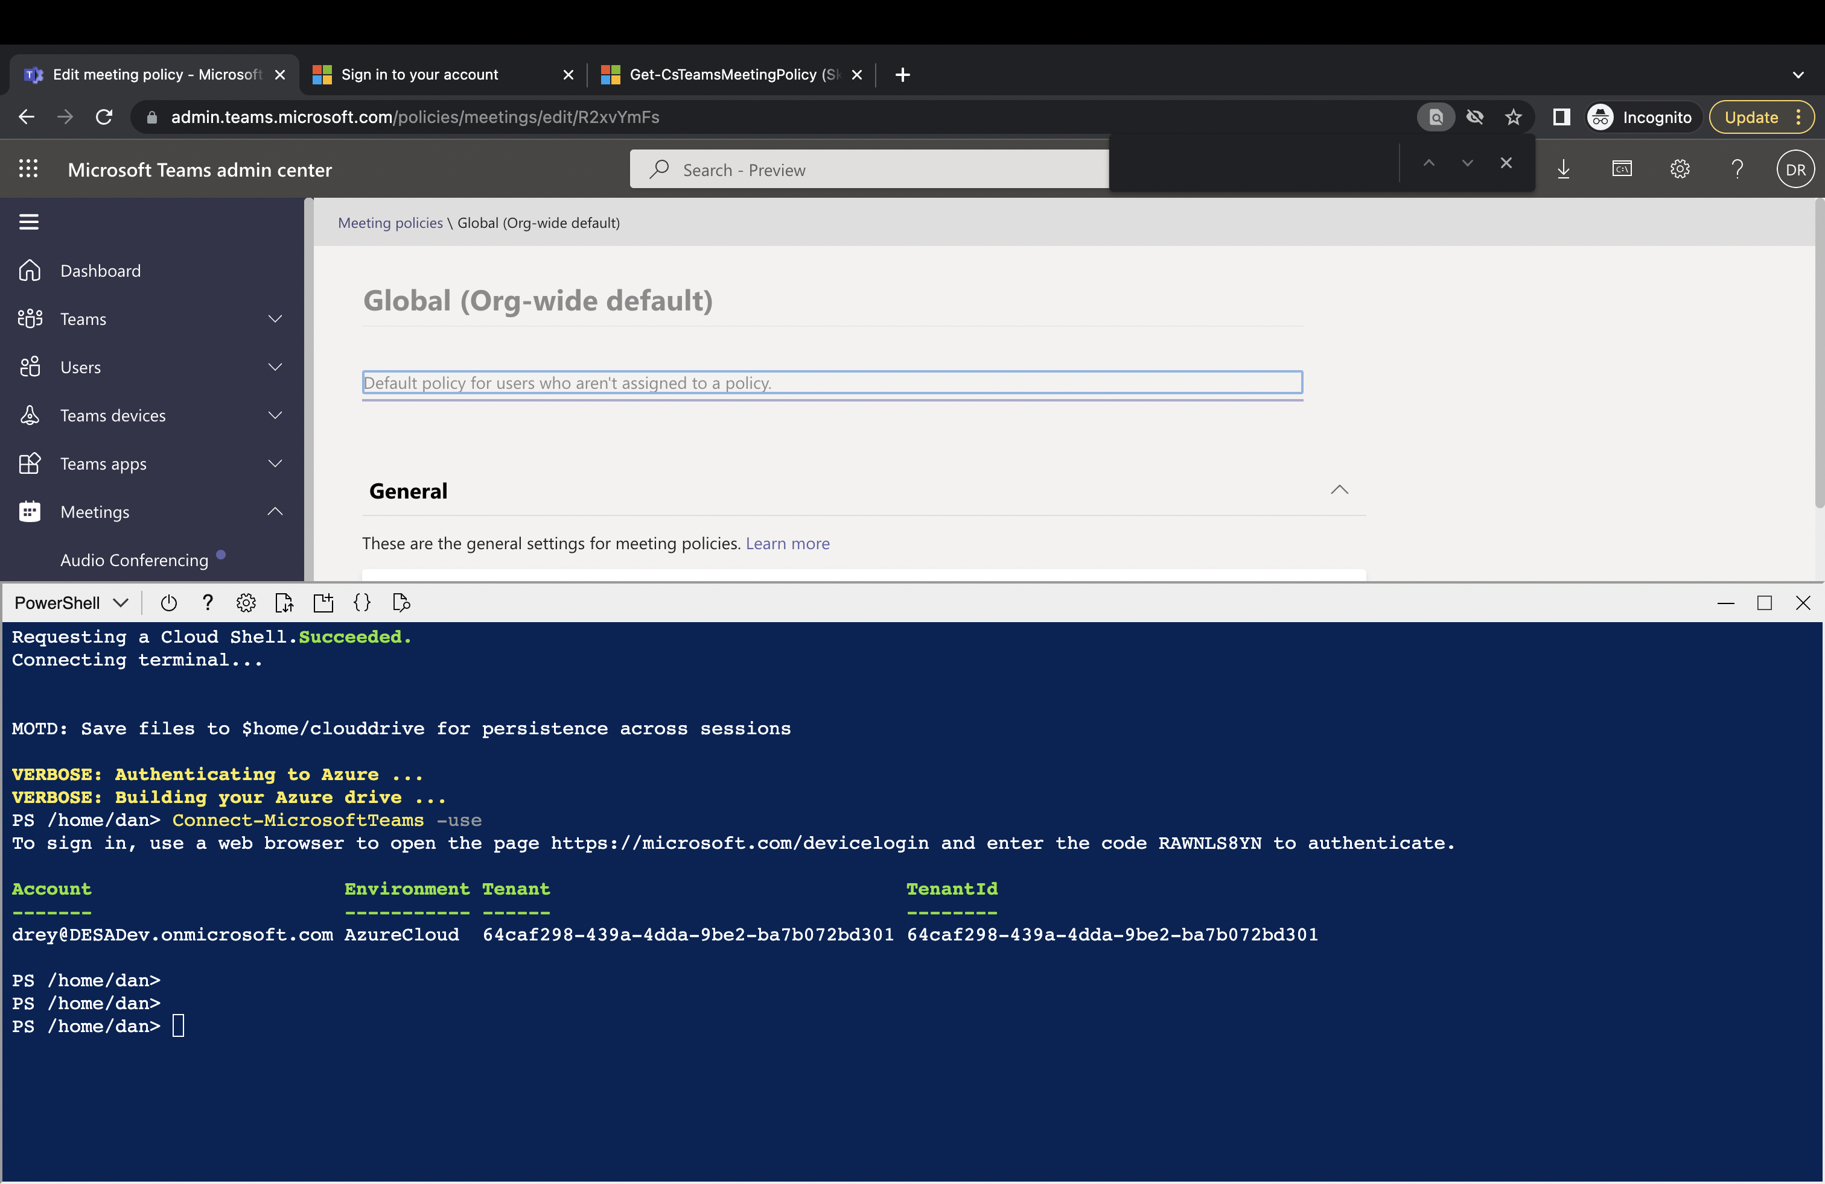
This is the output – you are now logged in!

Slide 8
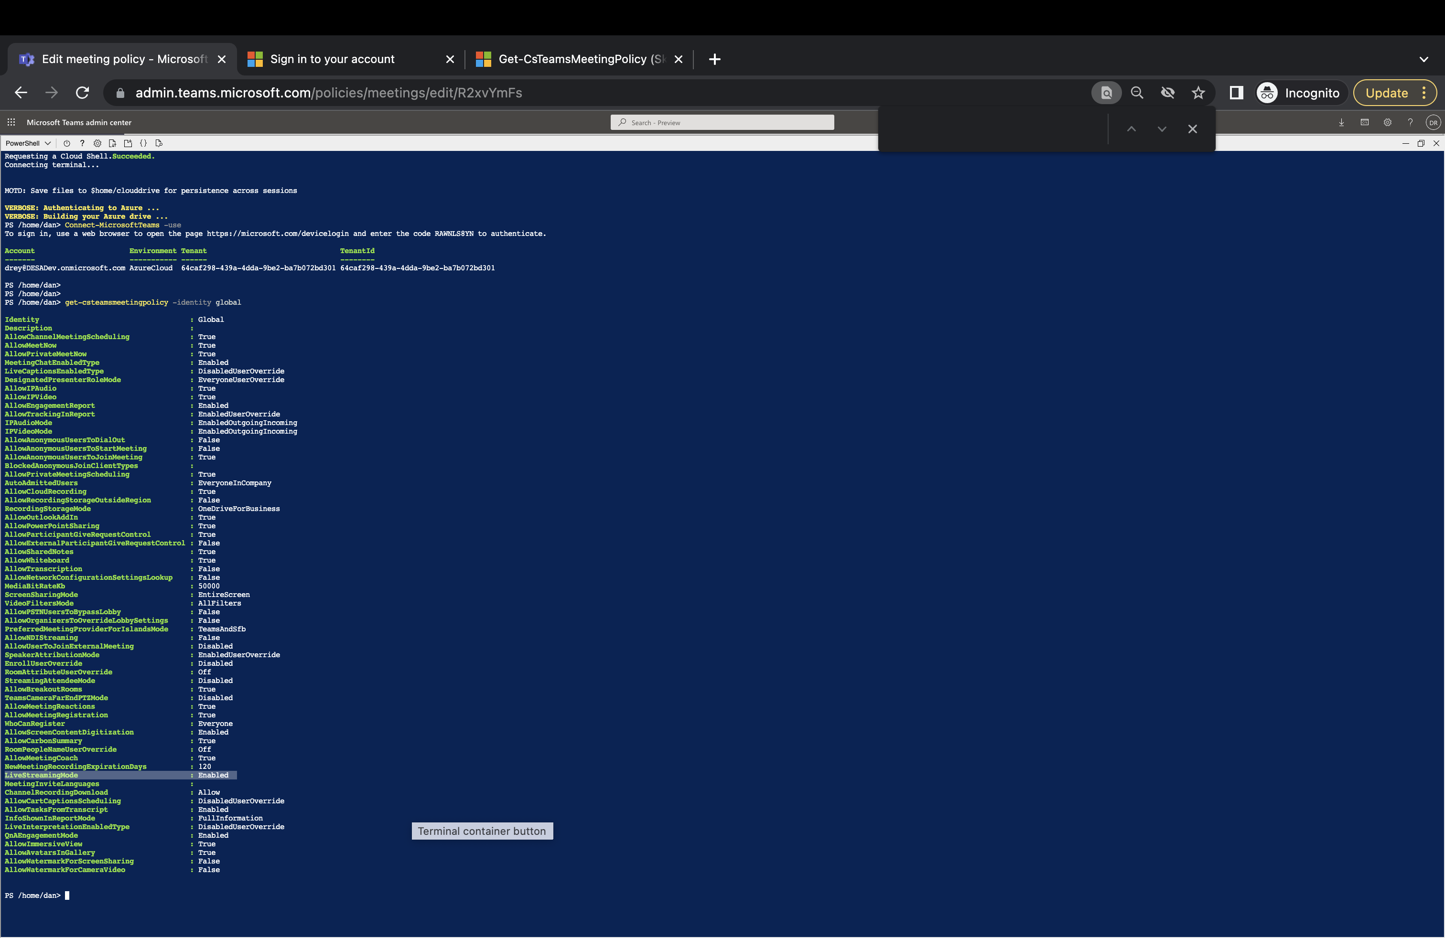
Get-CSTeamsMeetingPolicy (LiveStreamingMode Disabled By Default)

Slide 9
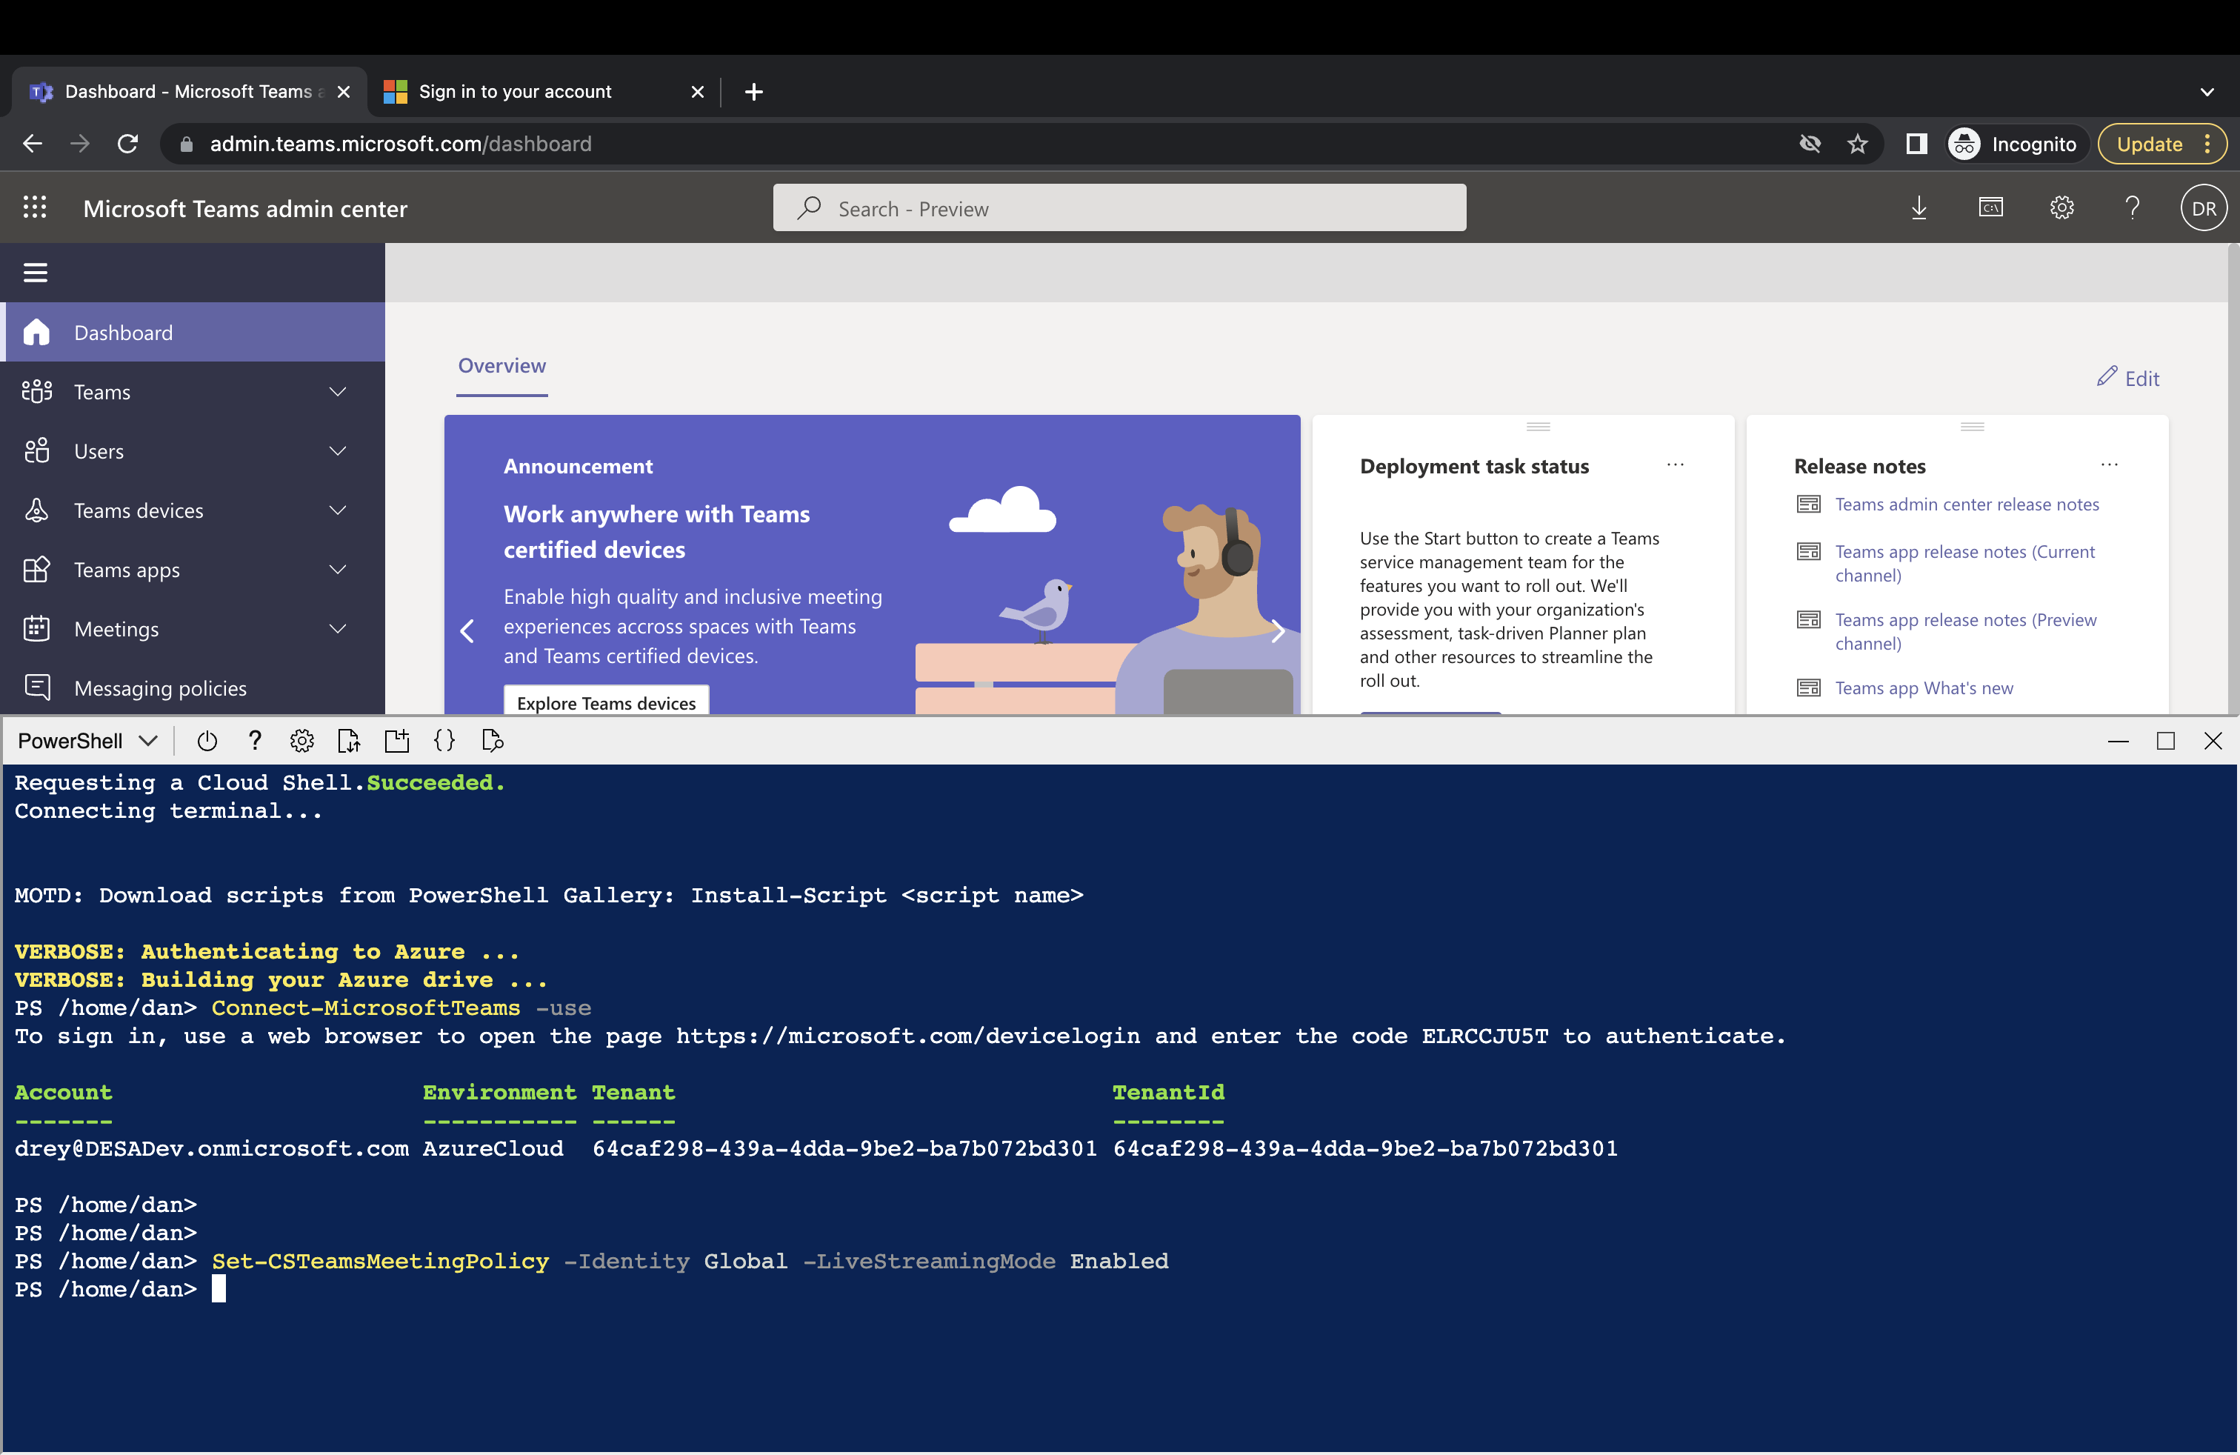
Set-CSTeamsMeetingPolicy –Identity Global –LiveStreamingMode Enabled

Slide 10
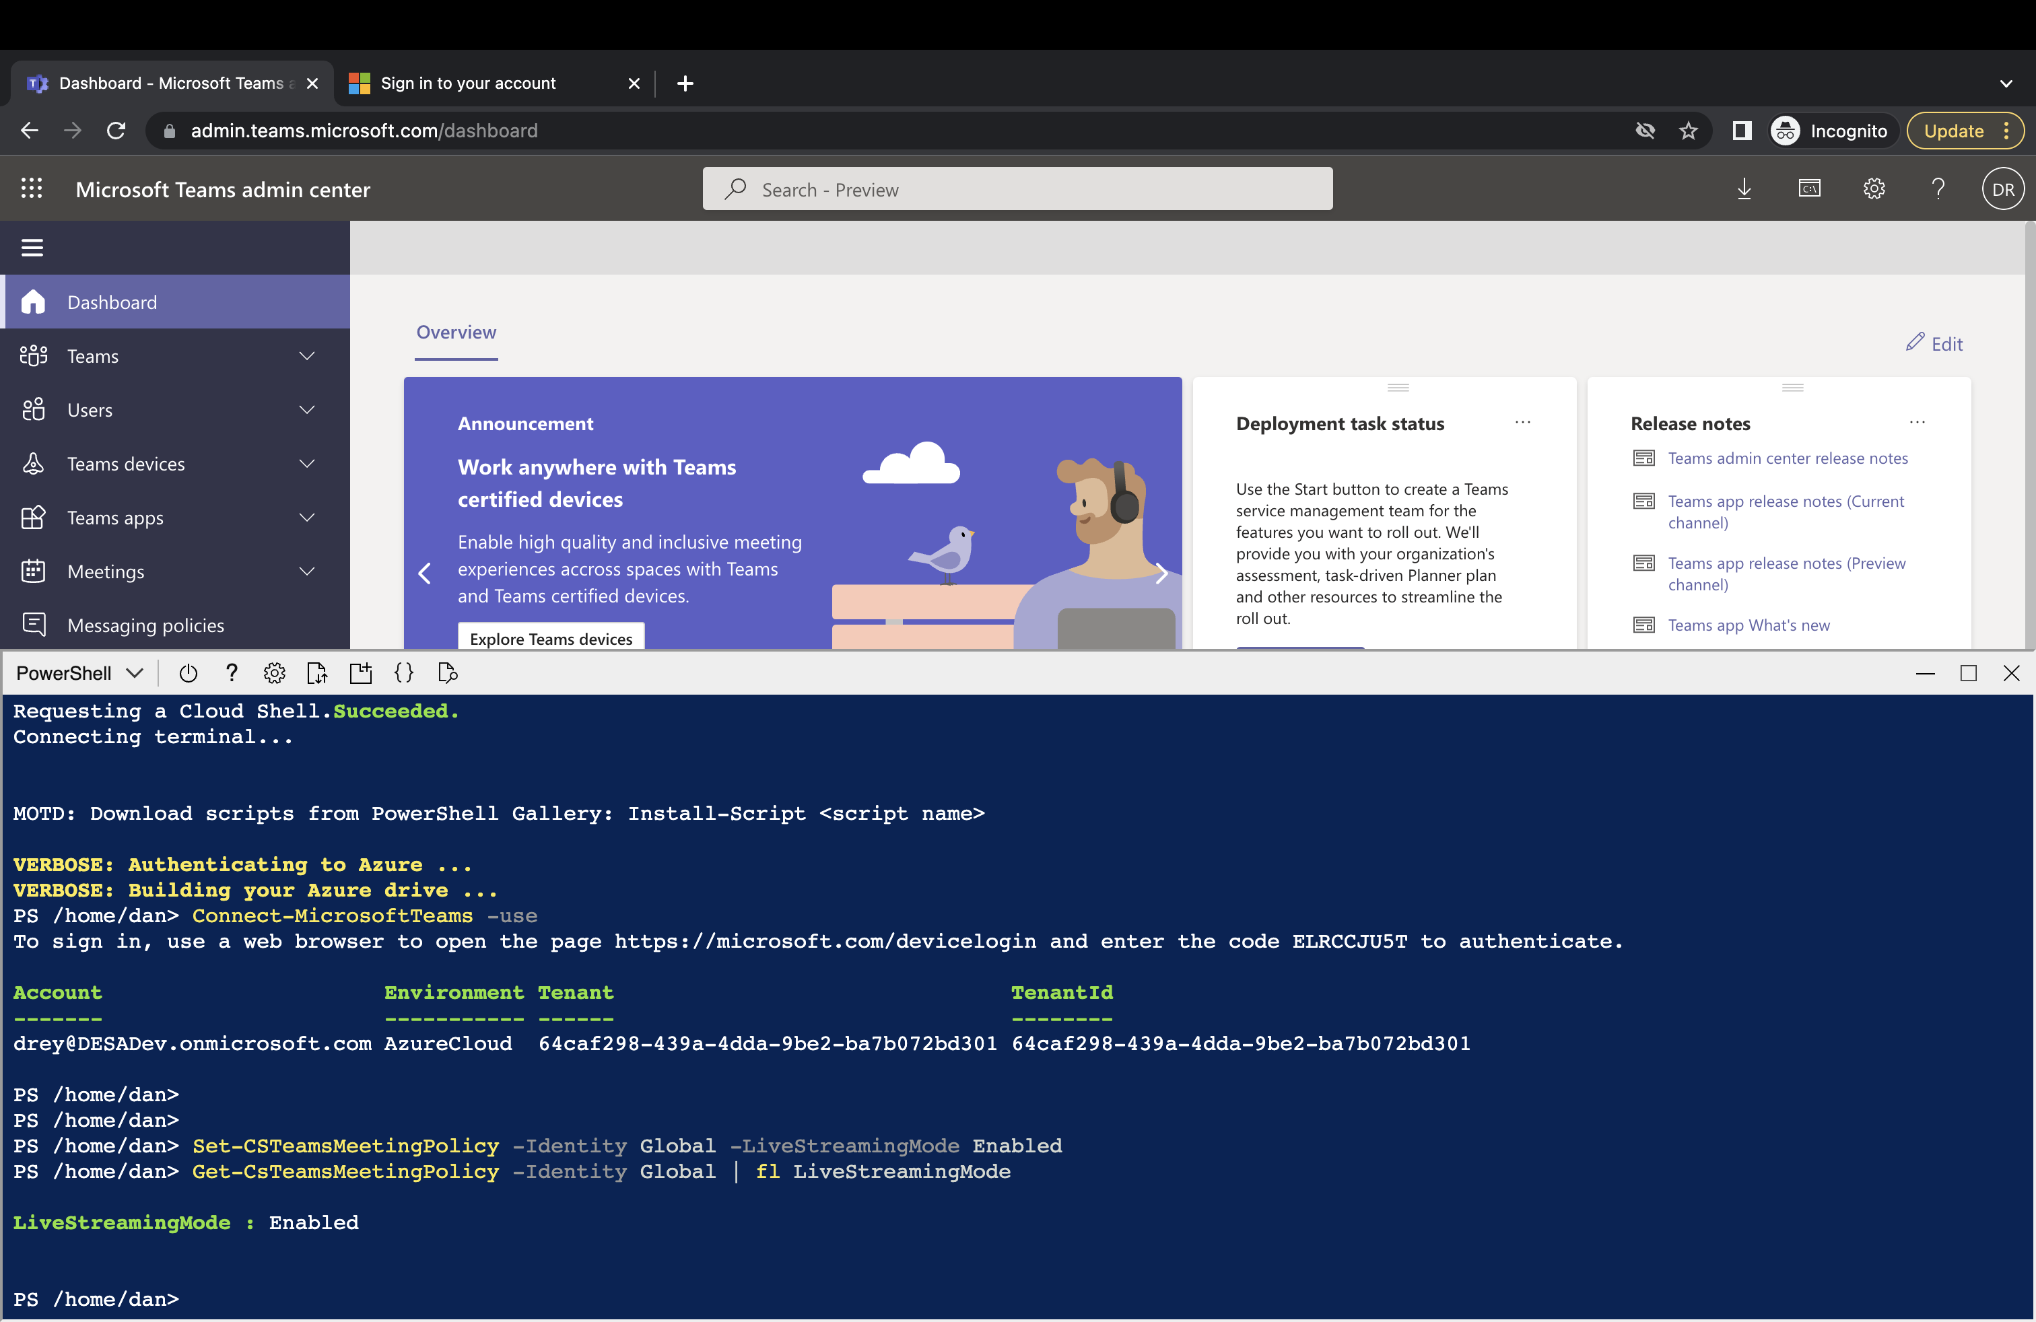
Get-csTeamsMeetingPolicy –Identity Global | fl LiveStreamingMode to confirm it’s enabled

Slide 11
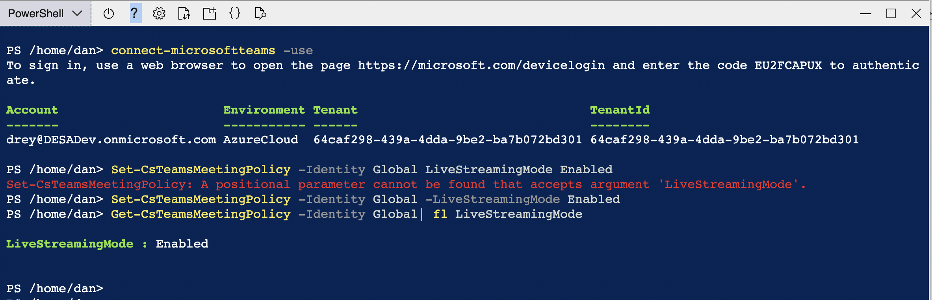
Tip: Use CloudShell to execute PowerShell from the Teams Admin Center (don’t have to install or update MicrosoftTeams PowerShell Module!)

Slide 12
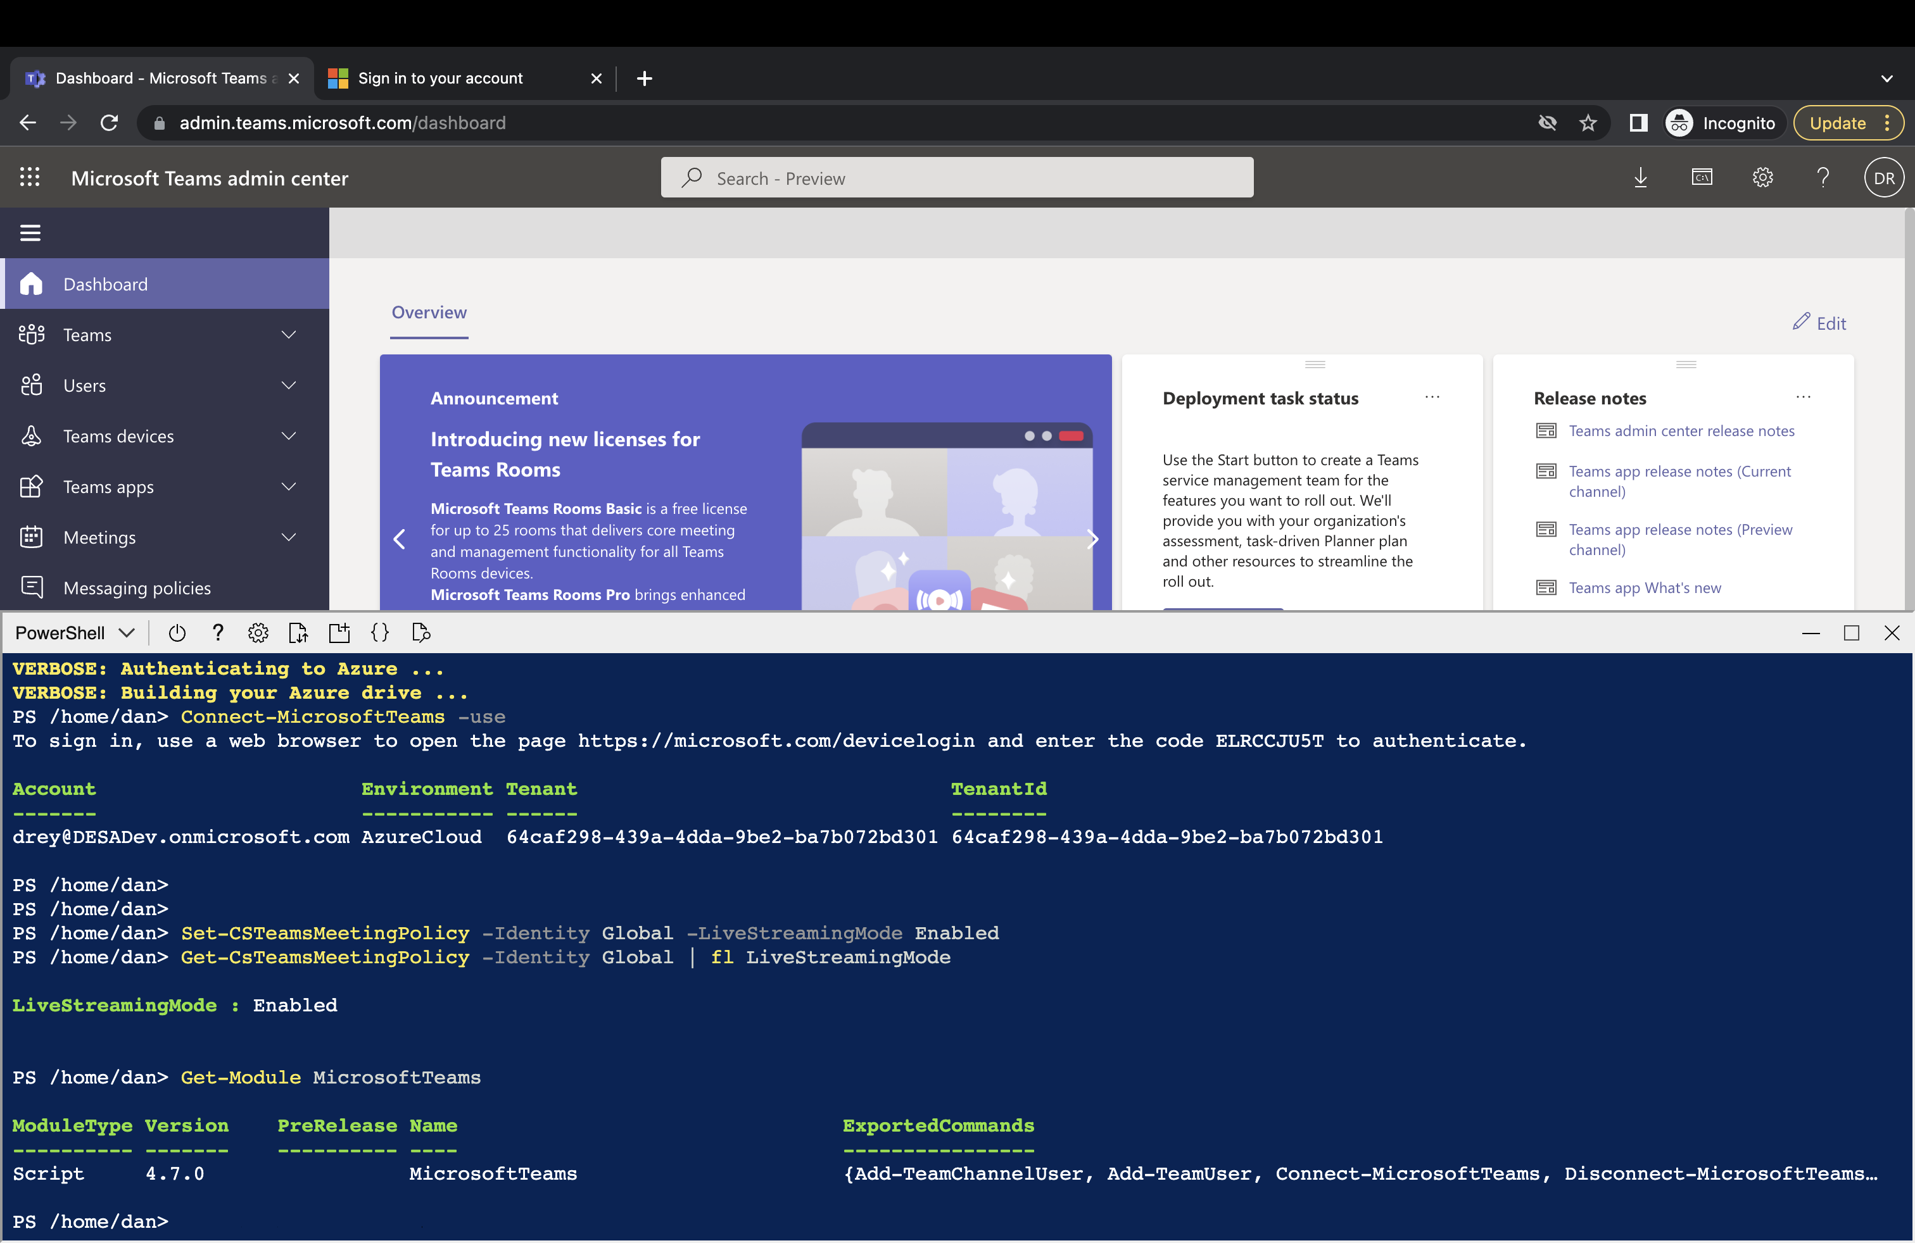
Get-Module MicrosoftTeams (4.7 already installed) – from local PowerShell type Install-Module MicrosoftTeams

Slide 13
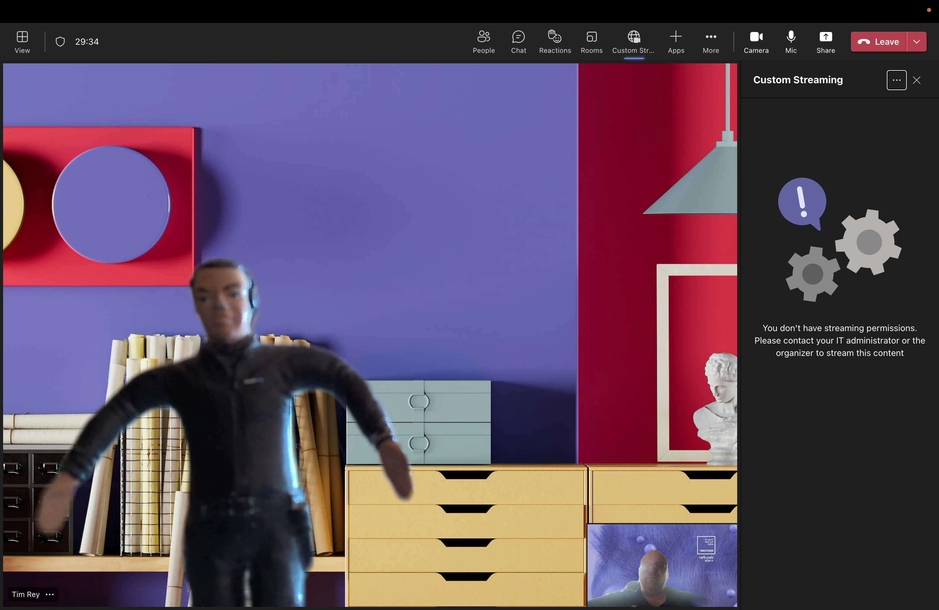
Add App – Custom Streaming to a Meeting

Slide 14
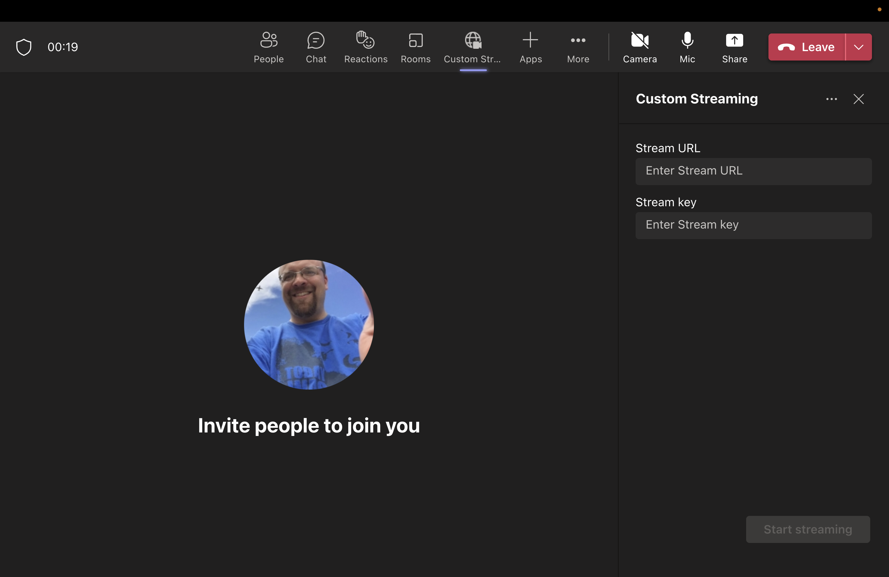
This is what it looks like once setting is enabled

Slide 15
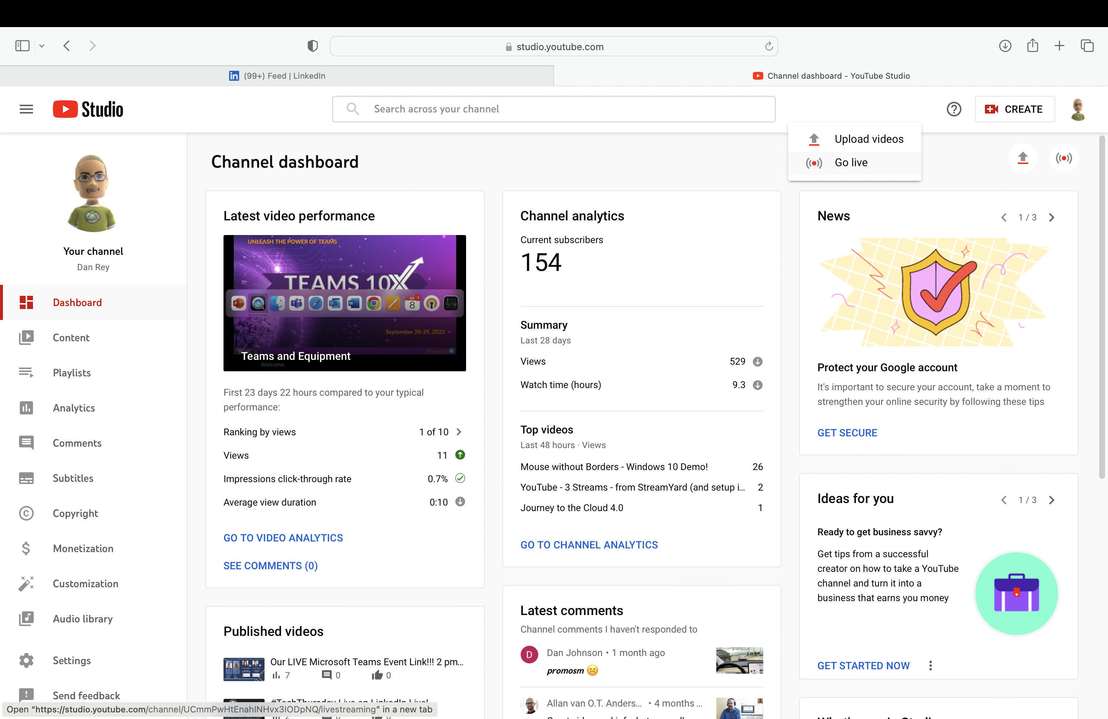
YouTube studio.youtube.com – create - golive
#1 Click Create
#2 Click Go live

Slide 16
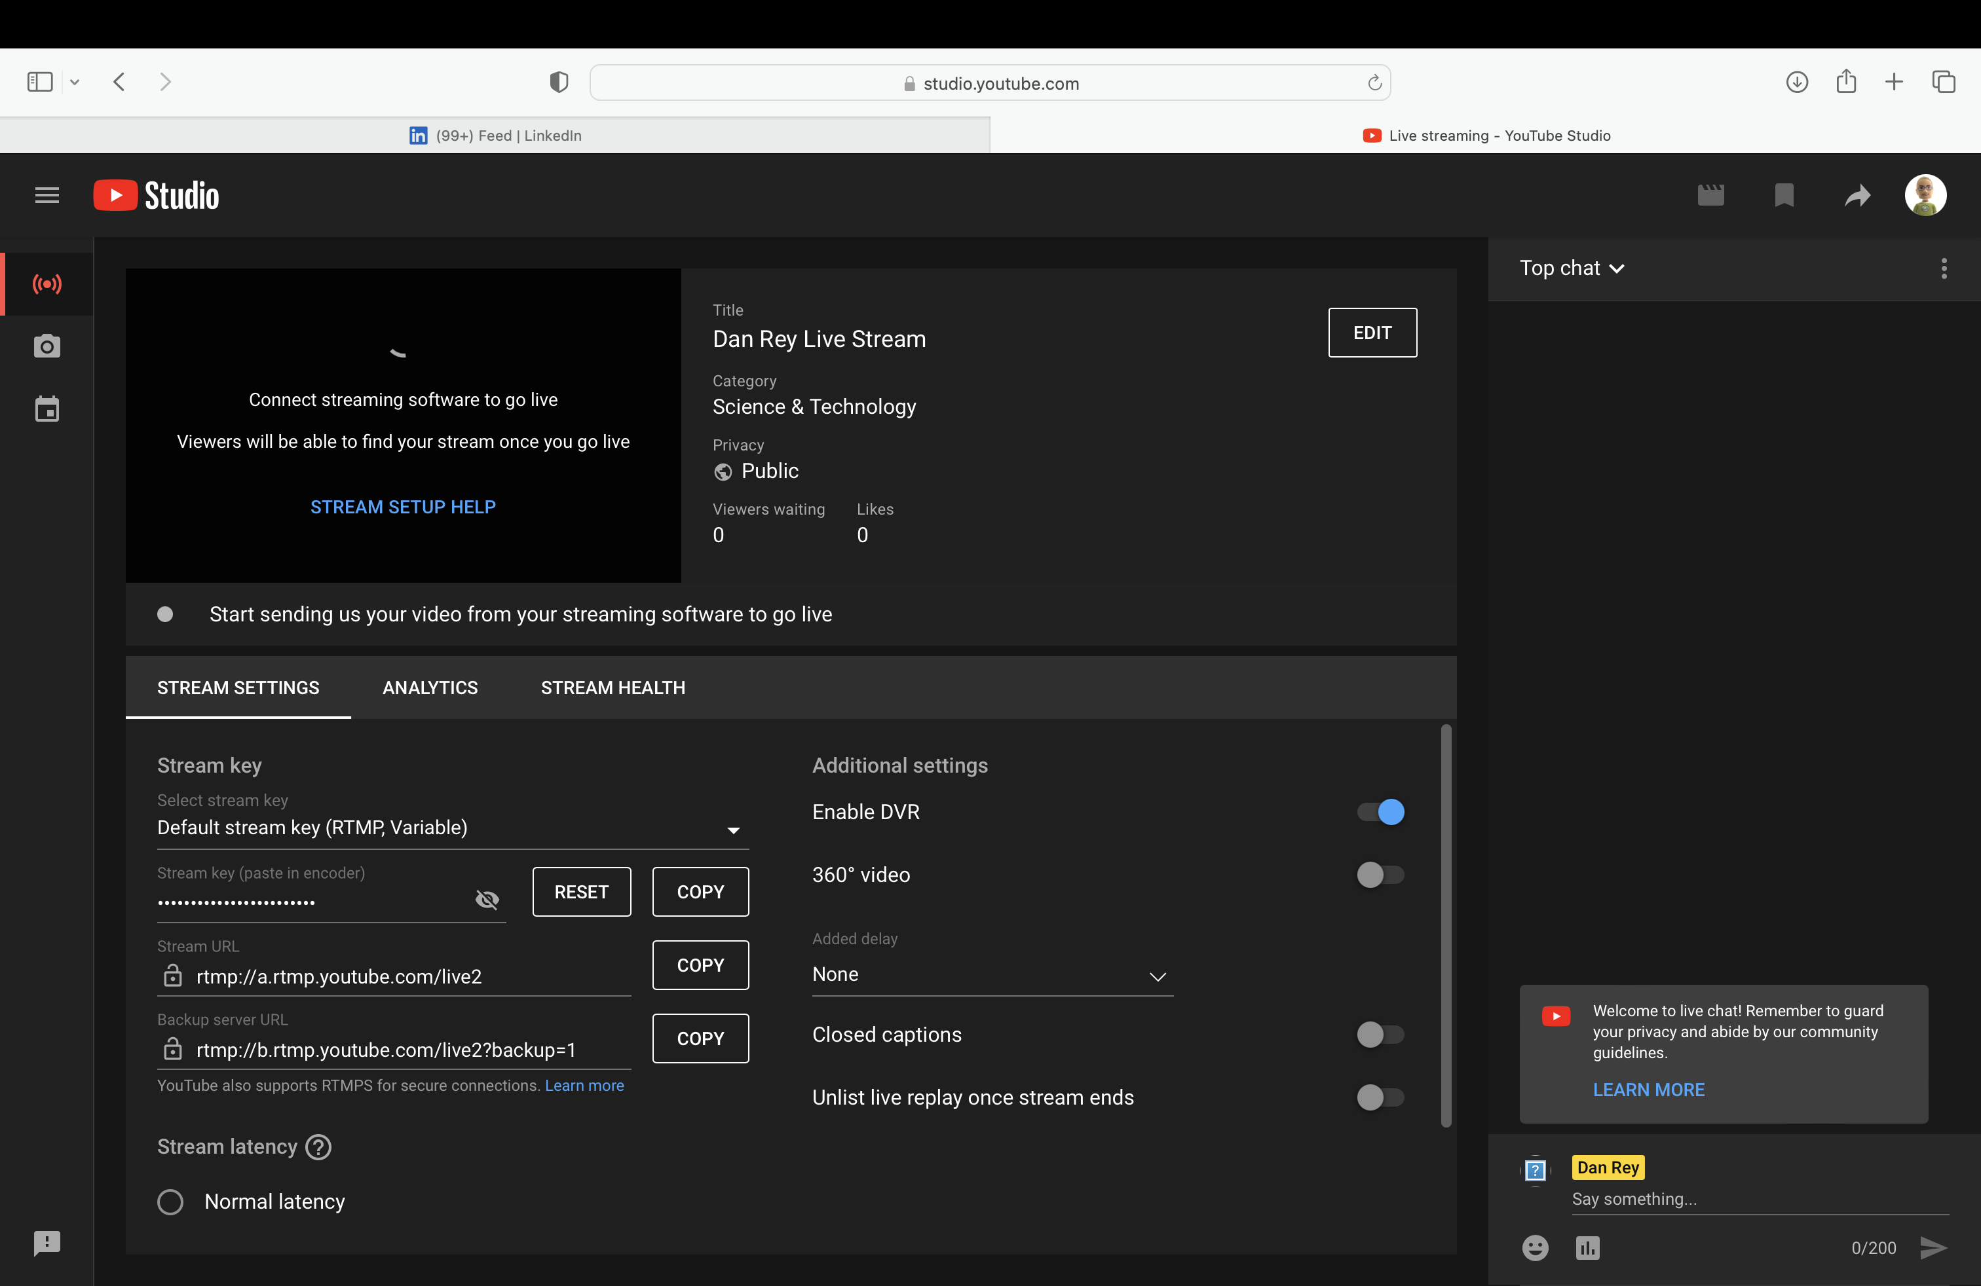
YouTube studio.youtube.com – create - golive
1 Click Stream
2 Copy Stream URL
3 Copy Stream Key

Slide 17
This is what it looks like once setting is enabled
1 Paste Stream URL
2 Paste Stream key

